Slide 1

Practical 20
Write a Program to Implement Search, insert, and Remove in Trie.

Slide 2

Lesson Plan
Subject/Course | Competitive Coding
Lesson Title | Write a Program to Implement Search, insert, and Remove in Trie.
Lesson Objectives
To understand the concept and structure of Trie (Prefix Tree).
To implement the basic Insert, Search, and Remove operations in a Trie.
To efficiently store and retrieve strings with common prefixes.
To handle deletion carefully so shared prefixes among words are not lost.
To analyze the time and space complexity of Trie operations.

Slide 3
Problem Statement:
Write a program to implement a Trie (prefix tree) that supports:
insert(String key) — insert a word into the trie
search(String key) — return true if the exact word exists
remove(String key) — delete a word from the trie (if it exists)

Slide 4
Concept
A Trie is a tree-like data structure used to store a dynamic set of strings where keys are usually strings.
Fast prefix-based operations: insert, search, and delete in time proportional to the length of the word O(L) where L is word length.
Useful for auto-complete, spell-checkers, dictionary implementations, and IP routing (prefix matching).

Slide 5
Algorithm/Logic
Insert
Start at root.
For each character ch in the word:
compute index (e.g., ch - 'a').
if children[index] is null, create new node.
move to children[index].
After last char, mark isEndOfWord = true.
Time: O(L) per insertion. Space: O(L) new nodes in worst case.

Slide 6
Algorithm/Logic
Search
Start at root.
For each character ch in the word:
follow children[index].
if at any step child is null → return false.
After last char, return node.isEndOfWord.
Time: O(L) per search.

Slide 7
Algorithm/Logic
Delete
Deleting a word requires careful handling to avoid removing nodes used by other words.
Use recursive helper that:
Traverses characters to the end.
Unmarks isEndOfWord at end.
On unwind, delete a child node if:
It has no children, and
isEndOfWord is false.
Return boolean to parent indicating whether child can be removed.
Time: O(L) per deletion.

Slide 8
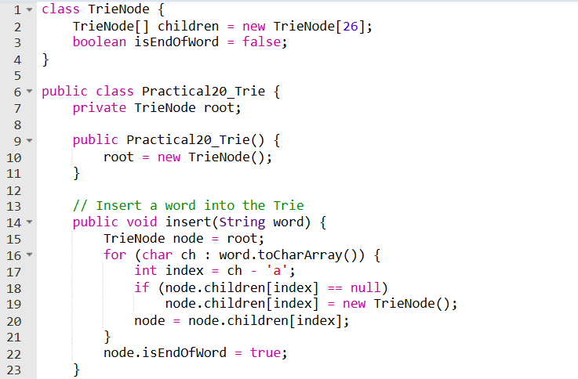
Code Implementation

Slide 9
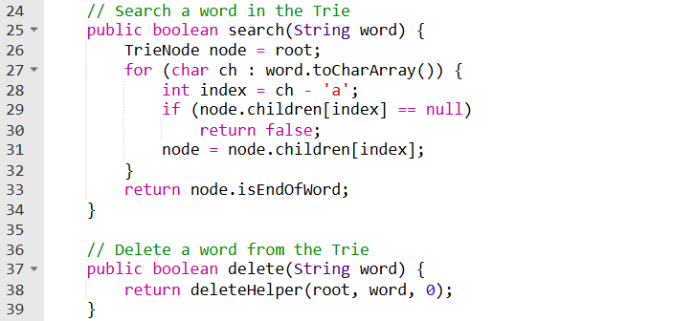

Slide 10
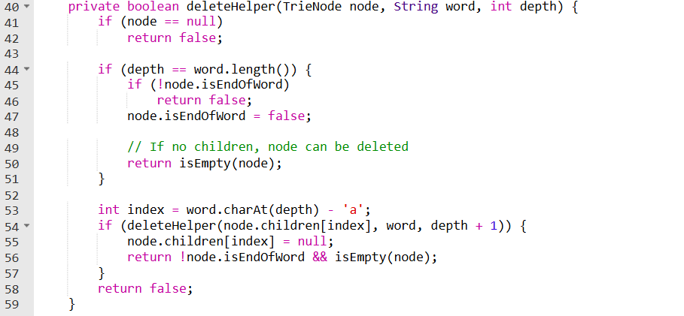

Slide 11
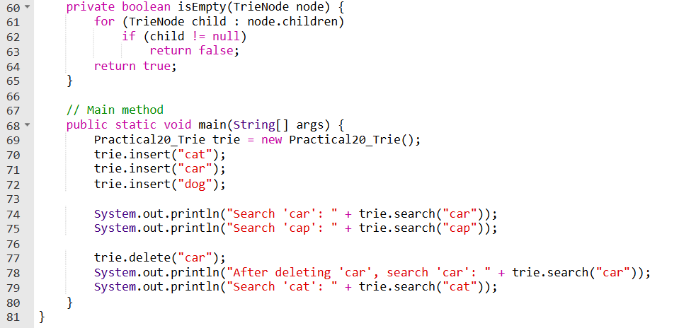

Slide 12
Output
Search 'car': true
Search 'cap': false
After deleting 'car', search 'car': false
Search 'cat': true

Slide 13
Time & Space Complexity
Time Complexity: O(L) per operation Space Complexity: O(26 × L) (for children references)

Slide 14
Summary
Efficient method to search pair adding up to target
Uses HashMap for instant lookup
Suitable for large inputs
One-pass solution

Slide 15
Summary
✅ Advantage:
Eliminates nested loops
Guaranteed faster performance
📌 Use Cases:
E-Commerce cart matching
Financial security validation
Data search operations

Slide 16
Practice Questions:
1️⃣ Implement Trie (Prefix Tree) — LeetCode #208
🔗 https://leetcode.com/problems/implement-trie-prefix-tree/
Concept: Build a Trie supporting insert(), search(), and startsWith() operations.
Why Practice: Directly matches this practical — helps master the basic structure and traversal logic of Trie.

Slide 17
Practice Questions:
2️⃣ Add and Search Word – Data Structure Design — LeetCode #211
🔗 https://leetcode.com/problems/add-and-search-word-data-structure-design/
Concept: Extend Trie to support wildcard searches using recursion (. can match any letter).
Why Practice: Strengthens understanding of Trie traversal and recursive pattern searching.

Slide 18
Practice Questions:
3️⃣ Replace Words — LeetCode #648
🔗 https://leetcode.com/problems/replace-words/
Concept: Use Trie to replace words in a sentence with the shortest root from a given dictionary.
Why Practice: Demonstrates how Trie can be applied in real-world tasks like text simplification and dictionary lookups.

Slide 19
Thanks

